Slide 1
Presentation Title
INSERT COMPANY LOGO HERE
Date
This document is proprietary in nature and is provided for the exclusive use of <<INSERT COMPANY NAME>> personnel.
The contents are not to be shared with outside parties unless prior written consent is obtained from CAST Management Consultants, Inc.

Slide 2
SUBHEADER – DELETE IF UNUSED
Text
Text
  Text
  Text
    Text
    Text
FOOTNOTES

Slide 3
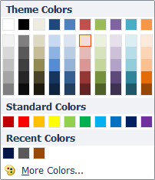
Below are examples of CAST standard shapes and colors.
Objects and text may be resized as necessary. All colors are found in the Microsoft “Office” standard color theme/palette. For more specific color information on the shapes (e.g., RGB colors ) refer to the CAST PowerPoint Presentation Standard document
Text
Text
Text
Text
Text
Text
Text
Text
Text
All colors are found in the Microsoft “Office”
standard color theme/palette
All shapes are solid colors with NO line*, shadow, 3-D effects, or transparency
Choose any color within the Microsoft Office standard color palette
*Lines may be used on text boxes for emphasis or when layering objects to help with legibility. Use a darker shade of the text box fill for the line color.

Slide 4
SAMPLE SLIDE LAYOUTS
(Use and delete as necessary)

Slide 5

Introduction to CAST Management Consultants
SAMPLE COVER PAGE
December 26, 2014
This document is proprietary in nature and is provided for the exclusive use of RBS personnel.
The contents are not to be shared with outside parties unless prior written consent is obtained from CAST Management Consultants, Inc.

Slide 6
The following presentation is designed to aid the staff of CAST
Management Consultants in the standardization of basic slide creation
This document expands on the following:
How to customize your workspace and work within PowerPoint
Basic design standards/conventions including page layout, matrixes, charts, graphs, etc.
The CAST color and black & white palettes
Helpful hints for creating slides more efficiently with the “CAST look”
Commonly clipped objects and commonly used templates
SAMPLE AGENDA PAGE

Slide 7
Sample Layouts
PROPOSED CAST STANDARDS
Title
TITLE
Text
  Text
  Text
    Text
      Text
TITLE
Text
  Text
  Text
    Text
      Text

Slide 8
Sample Layouts
PROPOSED CAST STANDARDS
Title
TITLE
TITLE
Text
  Text
  Text
    Text
      Text
Text
  Text
  Text
    Text
      Text
TITLE
TITLE
Text
  Text
  Text
    Text
      Text
Text
  Text
  Text
    Text
      Text

Slide 9
Sample Layouts
PROPOSED CAST STANDARDS
Title
TITLE
TITLE
Text
  Text
  Text
    Text
      Text
Text
  Text
  Text
    Text
      Text
TITLE
TITLE
Text
  Text
  Text
    Text
      Text
Text
  Text
  Text
    Text
      Text

Slide 10
Sample Layouts
PROPOSED CAST STANDARDS
Phase I
Phase II
Phase III
TEXT
TEXT
TEXT
Text
Text
Text
Text

Slide 11
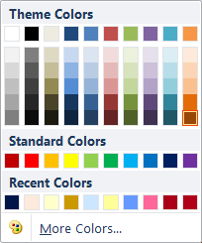
Not surprisingly, over 90% of the agents interviewed write more than half of their business in the advanced market
SUBHEADER – DELETE IF UNUSED
Percentage of Sales in Advanced Market
50% or Less
100%
51% - 80%
81% - 99%
Average Years in Life of Business: 22
Average Years in Advanced Market: 17
Average Percentage of Sales in Advanced Market: 85%
*Throughout this document, design standards are indicated by callouts, arrows, and explanatory text.

Slide 12
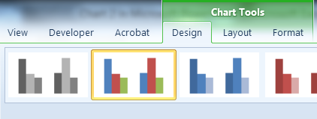
Column Charts
Standard Column Chart Colors
(From Microsoft Standard Office Theme)

Slide 13
Sample Chart Layout
Title
TITLE
TITLE
Text
Text

Slide 14
Table Examples
CAST STANDARDS
Tables
PROJECT SCOPE & KEY MILESTONES | APR ′10 | MAY ′10 | JUN ′10 | JUL ′10 | AUG ′10 | SEP ′10 | OCT ′10 | NOV ′10 | DEC ′10 | JAN ′11
Text
Text
Text
Text
PROJECT SCOPE & KEY MILESTONES | APR ′10 | MAY ′10 | JUN ′10 | JUL ′10 | AUG ′10 | SEP ′10 | OCT ′10 | NOV ′10 | DEC ′10 | JAN ′11
Text
Text
Text
Text
PROJECT SCOPE & KEY MILESTONES | APR ′10 | MAY ′10 | JUN ′10 | JUL ′10 | AUG ′10 | SEP ′10 | OCT ′10 | NOV ′10 | DEC ′10 | JAN ′11
Text
Text
Text
Text

Slide 15
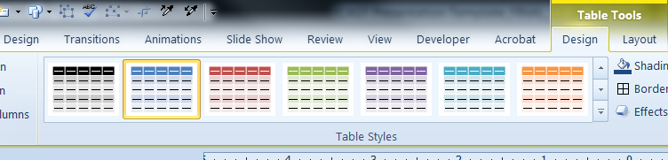
Table Examples
CAST STANDARDS
More Tables
(From Microsoft Office Design Theme)

Slide 16
CAST has significant experience working with its clients to drive measurable and sustainable improvements in sales performance
Overview of CAST’s Approach to Sales Effectiveness
Our primary focus is on driving increased client acquisition, product sales and revenue and client satisfaction and retention through:
  Refining the sales model to define the activities that lead to successful client/prospect interactions
  Improving sales capacity and role definition by clearly defining expectations, objectives and activities
  Creating a clear alignment of performance management and accountability through coaching, goal-setting, joint root cause analysis, incentive alignment and rewards and recognition programs
  Defining supporting tools, processes and structures to provide additional leverage to the sales process
Methodology
Benefits
We begin with a targeted diagnostic review of the sales process, relationship selling model, coaching, roles and all supporting tools and processes to quickly define prioritized areas of opportunity along with their likely impact, timing and ease of implementation
We identify the highest points of leverage in the process along with the current gaps to determine where to focus and we establish performance metrics/benchmarks to enable the measurement of results
We then refine the model, process, roles, coaching, tools associated with these points of leverage and implement them in a pilot region
We then refine the pilot and implement the model widely
Creation of clear proof points that demonstrate the rationale for widespread usage of the sales model
Creation of a clear chain of accountability at every level in the organization and increased retention of high performing sales resources
Creation of a client focused sales process that drives deeper, more valuable client relationships
Improved sales output and increased branch staff skill and confidence levels leading to widespread adoption
Leads to improved conversion of outbound calling sessions and service interactions into sales opportunities

Slide 17
Our approach is aimed at driving towards sustainable improvements as quickly as possible by focusing on high impact areas
High Level Approach:
Refinement/ Rollout Plan
Diagnostic Review of Sales Model & Process
Refinement and Redesign of High Impact Components
Pilot Testing & Detailed Design
Review and analysis of existing sales process documentation, roles, activities, objectives, goals, coaching and execution programs and incentive plans
Review and analysis of all current sales reporting, performance management data and supporting tools and systems
Interviews with Bankers, Bank Managers, Regional Managers and District Executives to understand process, issues and drivers of variability
Development of high-impact recommendations aimed at enhancing sales performance
Define major sales related processes and new enabling processes
Define detailed changes to sales process and model
Create proposed role design with competency models
Define structure, staffing needs goals and objectives
Define proposed changes to incentive system
Create coaching tools and sales support tools
Define system requirements
Define changes to performance measurement
Finalize Roles, Job Descriptions and structure
Finalize sales and coaching processes
Create detailed metrics, scorecards and unit and individual goals
Implement refined process in pilot offices
Finalize business case
Implement pilot unit to test concept
Create & refine pilot test
Refine key components of pilot
Develop enterprise roll-out plan
Finalize business case
Define change management
Define internal and external communications

Slide 18
CAST conducted a diagnostic review in October of 2009 which identified the following issues related to sales effectiveness
Sales Effectiveness Opportunities
Inconsistency in Execution, Coaching & Accountability
Staff Skill Level & Performance Management Discipline
Customer Needs Assessment Form, Process & Integration
Metrics Reporting Usage & Enhancements
PRIMARY DRIVERS OF VARIABILITY
Regional President Buy-In to Activity Based Sales Approach
Competing Priorities and Capacity Issues
Inconsistency in Outbound Calling Efforts
Span of Control and Definition of Regional Management Roles

Slide 19
The following are recommended next steps that were identified coming out of the Diagnostic Review
Recommended Next Steps
1
Refine the design, usage, scripting and coaching of the Customer Needs Assessment and better integrate with product set and client follow up process
Develop a more robust structured coaching tool for Regional Management to better engage them in the sales process and to build reinforcement
Focus the coaching process on creating better client interactions through CNA utilization, pre-call planning, objection response & asking the “right” questions
Construct a pilot to implement the refined program in a controlled manner, track key metrics, identify further refinements and prepare for Retail-wide launch
Refine the outbound calling program across the Retail network to create consistency in pre-call planning, call execution, outcome tracking and executive oversight
Integrate the refined components into a simplified, branded sales & coaching program and re-launch using the newly designed roles, tools and processes
Refine the reports and tools to be used in support of the sales effort to create a consistent performance measurement process and develop coaching on use
Develop a structured performance management process that links behavioral recruiting with a formal performance review/action plan and two-down reviews
2
3
4
5
6
7
8

